Slide 1
Flood Prediction and Alert System
Submitted in the partial fulfillment for the award of the degree of
BACHELOR OF ENGINEERING
IN
CSE-IoT
Submitted by:
Aman Jha (22BIT70031)
Raunak Kumar (22BIT70008)
Under the Supervision of:
Prof Abhishek Tiwari
Department of AIT-CSE
DISCOVER . LEARN . EMPOWER

Slide 2
Outline
Introduction
Research objectives
Literature Review
Conceptual Design and Methodology
Results and Outputs
Conclusion
Future Scope

Slide 3
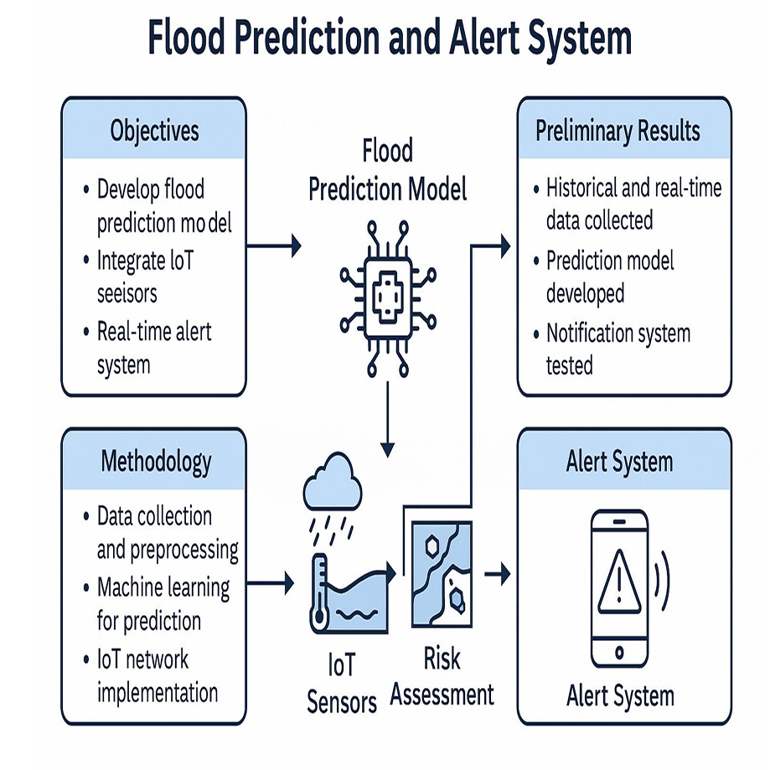
Introduction
Flooding is a major natural disaster that poses significant risks to human life, infrastructure, and the environment. Traditional flood forecasting and warning systems often rely on historical data and manual processes, which may not provide timely or accurate predictions. This project aims to develop a real-time Flood Prediction and Alert System leveraging modern data analytics, machine learning (ML), and Internet of Things (IoT) technologies. By combining predictive analytics with real-time sensor data, this system seeks to enhance flood prediction accuracy and provide early warnings to mitigate potential damage.

Slide 4
Research Objectives
The primary goal of the flood prediction and alert system is to develop an integrated, real-time, and accurate solution that can predict floods and provide timely alerts to communities and authorities, minimizing the impact of flooding events. This system should enhance preparedness, enable early evacuations, and support effective disaster management.
Objectives:-
Automate Alert System: Design an automated alert system that delivers real-time flood warnings to at-risk areas through multiple communication channels (SMS, email, mobile apps).
Improve Disaster Management: Support local governments and emergency services with flood risk mapping and prediction to allocate resources effectively and improve emergency response efforts.

Slide 5
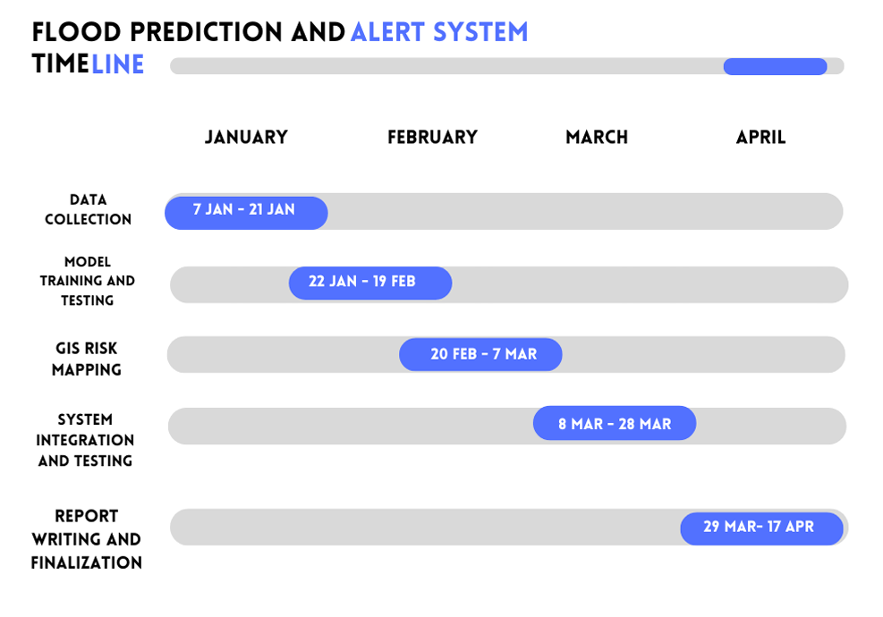
Proposed Timeline:

Slide 6
Literature Review
Flood prediction and early warning systems have been a critical area of research due to the devastating effects of floods on human life, infrastructure, and the economy. With the increase in extreme weather events due to climate change, accurate flood forecasting has become even more important. Traditionally, flood prediction relied on hydrological models that used physical data such as rainfall, river discharge, and historical flood records. However, these methods often had limited accuracy, especially in regions with sparse data or complex terrain.

Slide 7
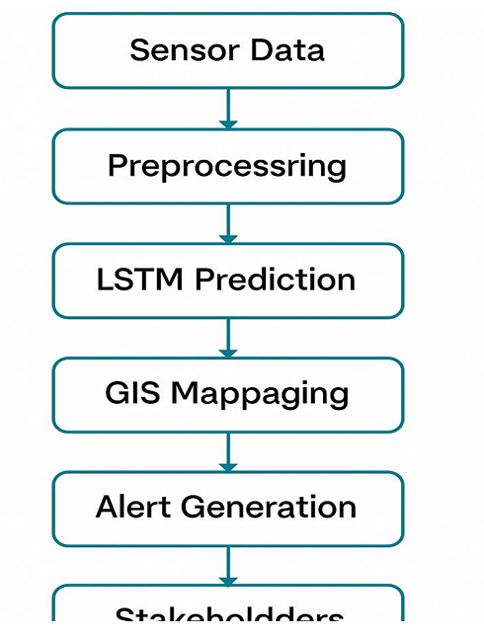
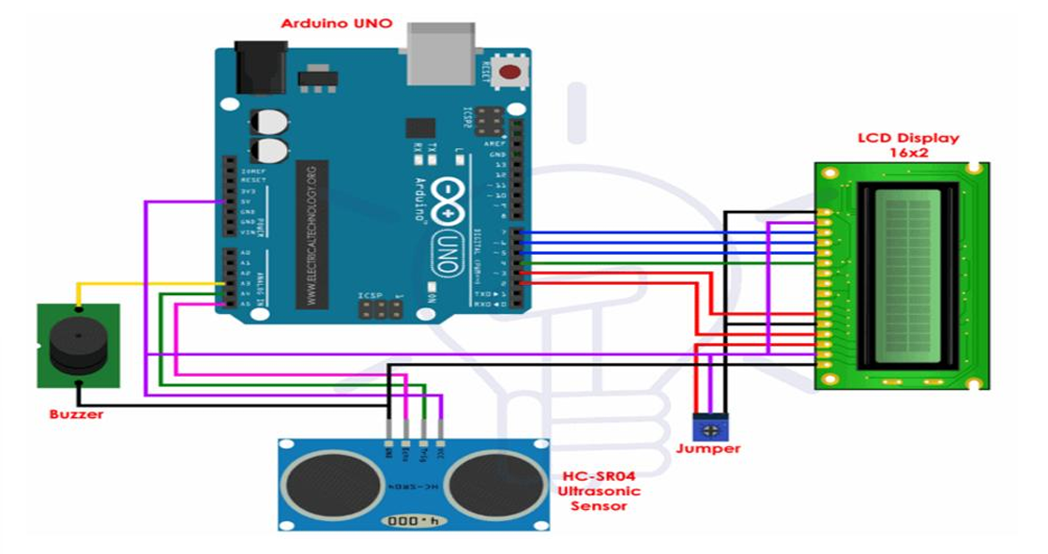
Conceptual Design and Methodology

Slide 8
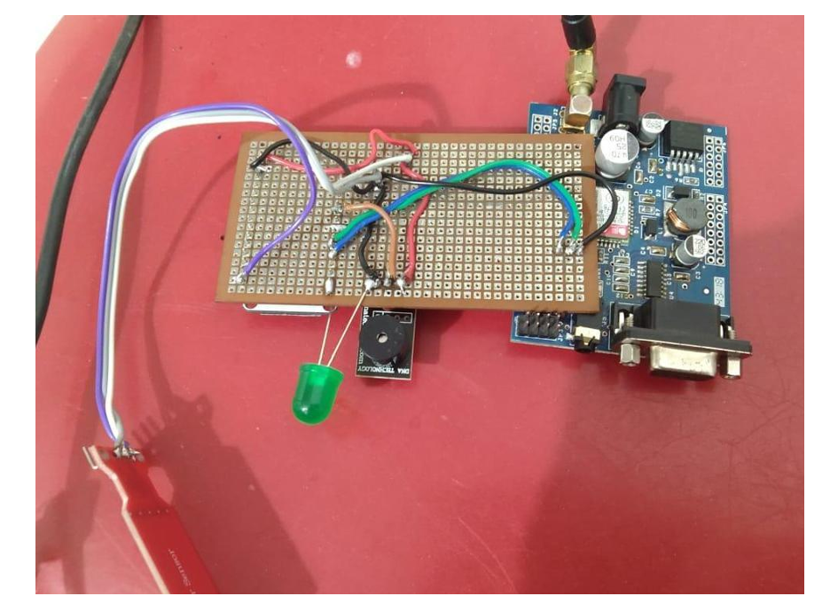
Practical Representation

Slide 9
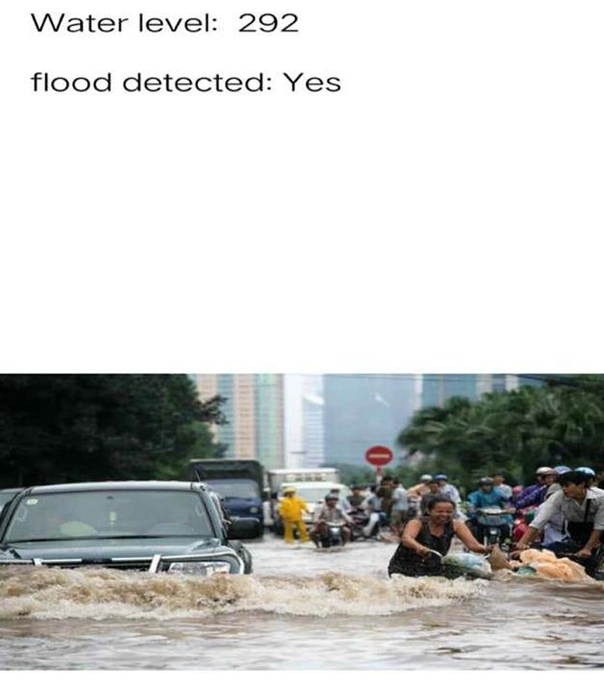
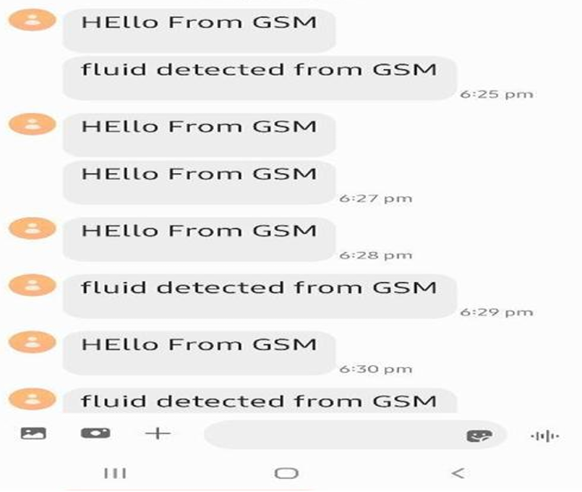
Results

Slide 10
CONCLUSION
By integrating real-time environmental data, machine learning models, and GIS based visualization tools, the system is capable of predicting potential flood risks with commendable accuracy.
The methodology employed — from extensive data collection and preprocessing to model development and system deployment — highlights a structured and scientific approach to solving a critical societal problem.
The system not only predicts flood occurrences but also ensures that timely alerts are communicated effectively through various channels such as SMS, mobile notifications, and web dashboards.

Slide 11
Future Scopes
Incorporating additional data sources such as satellite imagery, snowmelt data, and drone-based local surveys could further improve the system’s prediction capabilities.
The development of more advanced deep learning models, such as Convolutional LSTM networks, could enable more accurate modelling of complex flood patterns over both time and space.
Expanding the GIS component to include real-time, high-resolution flood maps would offer users a more detailed understanding of evolving flood risks.

